Slide 1

INTERVIEW SKILLS

Slide 2
What do you mean by interview?
It’s a chance for you to get to know each other and find out whether there is a good fit of
Knowledge and skills
Experience
Attitude(Someone who is genuinely interested in the company and who they think will fit in with the culture and team)

Slide 3
INTERVIEW
I – Build on your Intelligence
N – Natural is best
T – Tell the Truth
E – Engage your panel
R - Relate at a personal level
V - Values make you who you are
I – Imagination adds a little spice
E – Eagerness to belong
W – Wow effect

Slide 4
Facing an Interview

Slide 5

It’s time to sell yourself

Slide 6
TYPES OF INTERVIEWS
One-to-one Interview
Telephonic Interview
Videoconference Interview
Group/Panel Interview

Slide 7
3 STEPS FORMULA TO CRACK AN INTERVIEW
BEFORE THE INTERVIEW
DURING THE INTERVIEW
AFTER THE INTERVIEW

Slide 8
BEFORE THE INTERVIEW
1. Understanding Job Opportunities
2. Researching the Company and Job
3. Practice technical and non technical questions
4. Update your resume
5. Collect all relevant documents
6. Calculate time required to reach the destination
7. Grooming and Dressing

Slide 9
DURING THE INTERVIEW
Ensure consistency in your responses
Mind your Manners
Take charge of body language ( eye contact, gestures, postures, handshake)
Avoid repetition words ( actually, basically, typically, normally)
Reflect confidence

Slide 10

How to Answer toughest questions

Slide 11
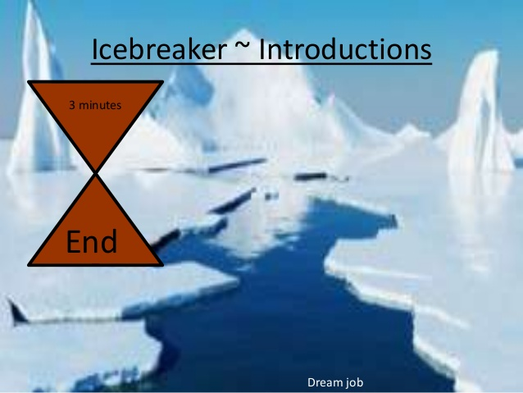
Take me through your CV?

Slide 12
TAKE ME THROUGH YOUR CV?
Greeting with thank you statement
Name
Location
Highest qualification, with MBA ( why MBA)
Professional certificate course ( optional )
Experience/project in detail
Skills achieved through experience / project
Giving a confidence of doing a job

Slide 13
TAKE ME THROUGH YOUR CV? ( IT)
Greeting with thank you statement
Name
Location
Highest qualification + experience
Professional certificate course
Experience/project in detail
Skills achieved through experience / project
Giving a confidence of doing a job

Slide 14
My Answer
Sir / madam, I thank you for the time and opportunity given. My name is Sukrut Patwardhan. I am from Pune. I have successfully completed my Graduation in electronics and telecommunication and technical certification from ITP which is 6 months course. The training course includes C language, UX UI, sql , plsql and specialization in java we worked on the projects and now confident to work on technologies. .( Sir, madam, I did some research in IT industry and if you see now a days IT is the foundation of most of the industries which creates opportunities, growth. Now a days we have to use the technology for automation for any project management) Based on my overall training I have 2 skills which are important to start my IT career. i.e. Analytical skills and assertive attitude. I would like to take this opportunity to confirm that if given an opportunity, I can add value in your organization and can become an asset of your organization

Slide 15
TELL ME ABOUT YOUR FAMILY BACKGROUND?

Slide 16
GIVE ME YOUR STRENGTH AND WEAKNESS?
My strengths are creativity, punctuality. My weakness is stress level. (I think taking stress is my nature….which I have reduced) so I have completed hypnosis program to overcome my weakness and I am constantly working on it.

Slide 17
List of strengths and weaknesses
Strengths | Weaknesses
Self starter | Aggressive
Enthusiastic | Inconsistent
punctual | Bad time management
Confidence | Not focused
Creative | Short tempered
Flexible | Very emotional
dedication | Less confident
Sincere | lazy
Honest | Workaholic
Hardworking | Not creative
Friendly | Bad handwriting

Slide 18
WHAT DO YOU KNOW ABOUT OUR COMPNAY?

Slide 19
Answer
About Us
Leadership Team
Product and services
CSR
Locations
Vision, mission and values
Year of establishment

Slide 20
Why IT?
Technology and Automation are the need of an hour
The Indian technology and IT industry was projected to grow at around 5.1% in FY2025, reaching about $282.6 billion in total revenue (including services, products, hardware).
NASSCOM expects the sector to cross the $300 billion mark in FY2026 — roughly a 6% increase over FY2025 figures.
A Variety of Career Opportunities ( Data Scientists, Artificial Intelligence Professionals, Cyber Security Professionals, Machine Learning Professionals, Full Stack Developers, Cloud Computing Professionals, Software Engineers, DevOps Engineer.

Slide 21
Why MBA?
1. Develop advanced and flexible management skills
2. A lot of MBA specializations to fit your exact goals
3. Access to an extensive business network
4. MBA salaries are some of the highest on the job market
5. Start your own company from scratch

Slide 22
Why MBA?
6. MBAs are great for a career change and thriving business opportunities
7. Study excellent MBAs all over the world
8. Earning Credibility
9. Developing a broader perspective
10. Enhancing your knowledge and skills

Slide 23
WHY MBA
After graduation I wanted to expand my career towards specialization. It also gives an opportunity to master management skills. It gives me the understanding of business dimensions which helps me to create global opportunities and growth. So I decided to complete my MBA with specialization in Marketing.

Slide 24
Top Sectors
Healthcare and Insurance Sector. ...
Renewable Energy Sector. ...
IT Sector. ...
Real Estate Sector. ...
Fast-Moving Consumer-Goods Sector (FMCG)
Automobile Sector.

Slide 25
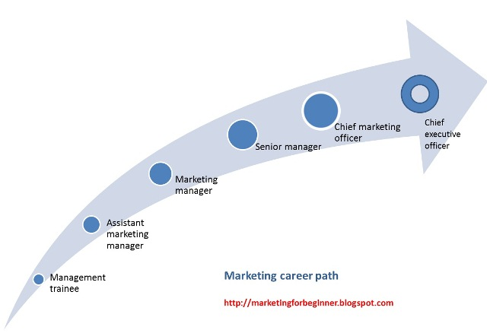
Why Marketing?
Great Career Opportunities

Slide 26
Marketing is a versatile field
Law
Healthcare
Technology
Real Estate
Entertainment
Education
Food
Retail

Slide 27
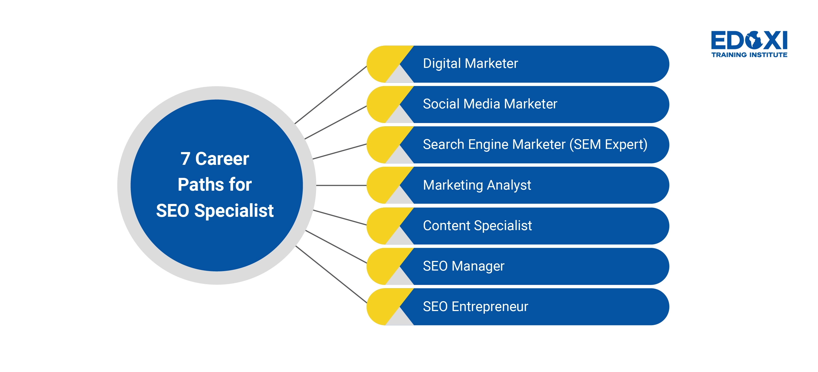
Marketing is dynamic

Slide 28
A Marketing MBA Will Expand Your Business Knowledge
Economics
Business trends
Consumer demands and behavior
Marketing and sales
Brand promotion

Slide 29
Why Marketing
Marketing is a highly competitive and rewarding field. Businesses across every industry rely on marketing professionals to generate awareness of their brand and increase sales of their products and services. My understanding is only Marketing and Sales represents profit of an organization. My skills also match to start the career in marketing as I believe that I am a strategic and problem- solver, however a career in marketing could be right for me

Slide 30
Why Finance?
Chance to Explore Various Job Roles
High in Demand
Lucrative Pay Packages
Ensures Holistic Development
The Wide Curriculum
Start a New Venture

Slide 31
Jobs in Finance
1.Investment Manager
2.Fund Manager
3.Investment officer
4.Stock Analysts
5.Branch Manager
6.Junior Dealer
7.Junior Manager
8.Junior Stock Analysts

Slide 32
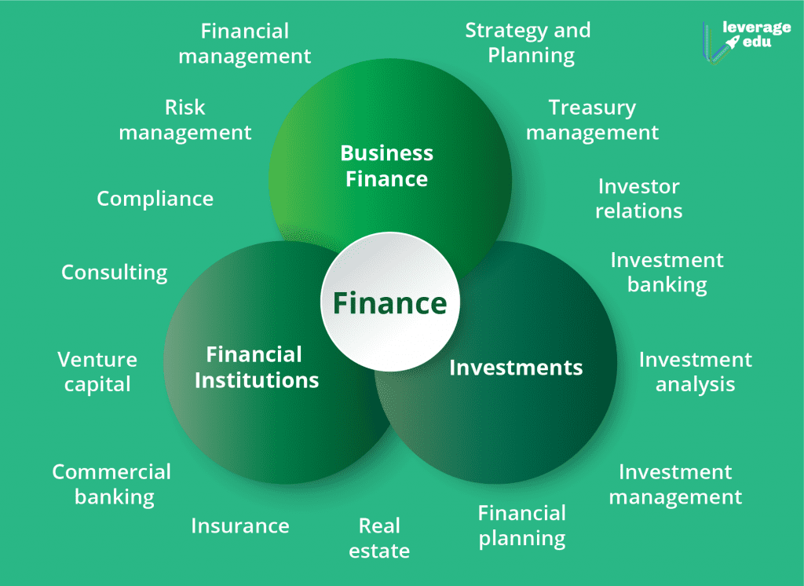

Slide 33
Top Recruiters
JP Morgan
Barclays
Bain and Company
Boston Consulting Group
Morgan Stanely
Goldman Sachs
KPMG
Deloitte
State Bank of India
HDFC

Slide 34
Why Finance
Finance and funds are known as the lifeblood of any business. You simply cannot function properly unless you have an adequate amount of money accessible to you and your business. It is the management of money and includes activities such as investing, borrowing, lending, budgeting, saving, and forecasting. I have learnt strategic skills, financial management which will help me to start my career

Slide 35
WHY HR?

Slide 36
WHY HR?
1. You’ll be in a position of influence
2. You’ll have the chance to change lives
3. You can help develop the people around you
4. The field is experiencing steady growth
5. You’ll feel gratification from solving problems
6. Each workday will be different
7. You’ll get to guide others in their careers
8. You’ll get to work with people

Slide 37
Opportunities
Recruitment
Training and development
Employee benefits
Co-ordination with employees
Manage Payroll
Manage compensation
Policy/Compliance

Slide 38
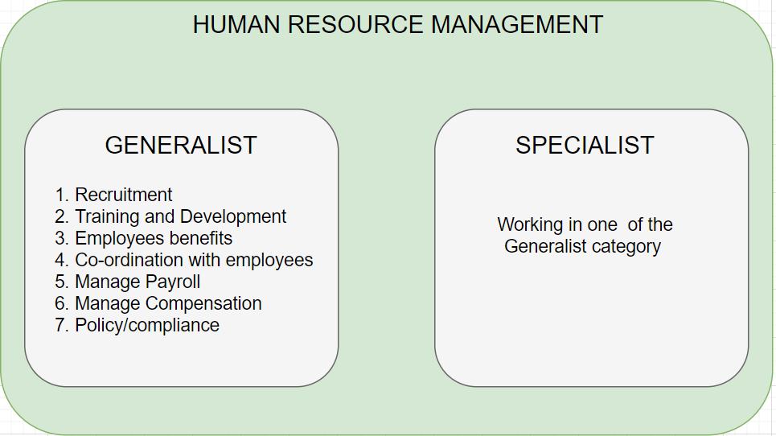

Slide 39
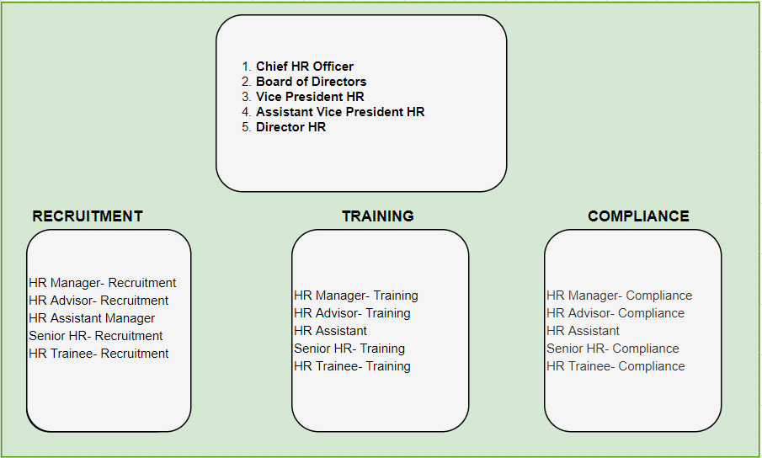
HR career in BPO, Corporate sectors, Service sector

Slide 40
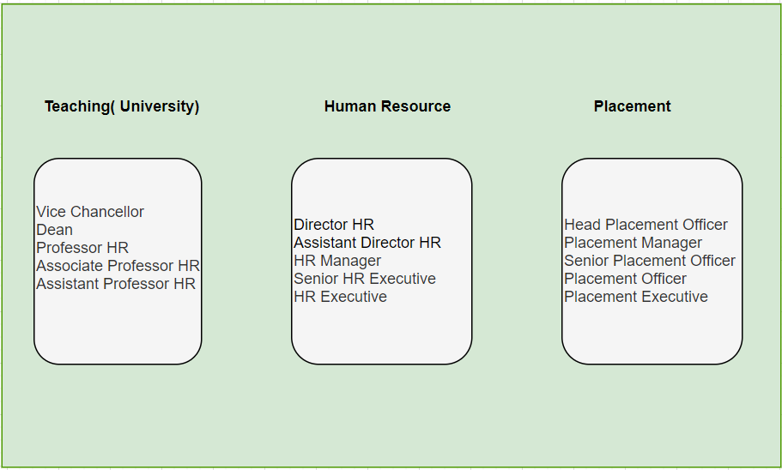
HR career in the Education sector

Slide 41
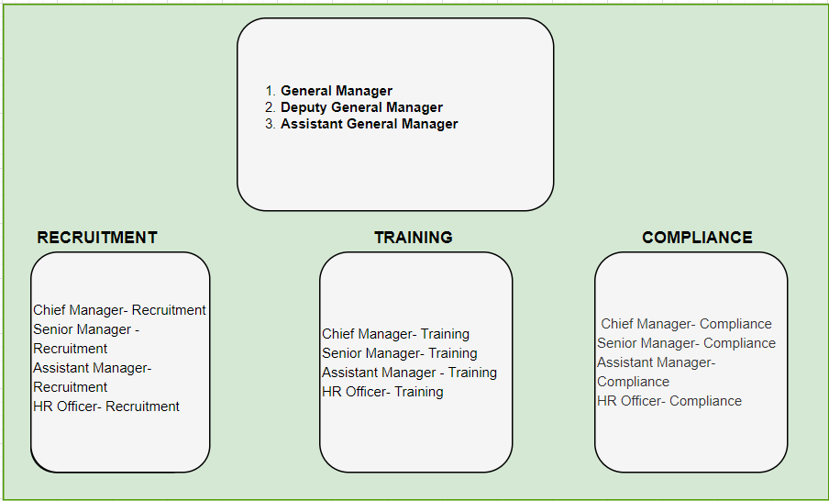
HR career in the Banking sector

Slide 42
Why HR
As per my research, A human resource department is also in charge of keeping employees safe, healthy, and happy. Human Resources manages 5 main duties: talent management, compensation and employee benefits, training and development, compliance, and workplace safety. Humans can be the asset of the organization and company grows if people are happy and motivated .

Slide 43
WHERE DO YOU SEE YOURSELF AFTER 5 YEARS?
I will see myself as a motivational speaker and leadership coach because motivation is something which creates burning desire in mind and body to achieve goals if I get success then actually I am the most successful person to change lives of people. And in the journey of 5 years I believe I’ll develop skills which are required to handle this responsible position.

Slide 44
Answer for IT
I will see myself as a team leader because I am sure that I will achieve technical expertise / Domain expertise by certifications and working on different projects and I will develop my leadership ability to handle and manage my team.

Slide 45
MY JOURNEY IN 12 YEARS
B.E.( E AND TC)
PGDBA(HR)
12 + INTERNATIONAL CERTIFICATIONS
53 CLIENTS

Slide 46
Why Should you be hired?
Knowledge
Skills
Attitude
Experience

Slide 47
Answer
Sir / Madam, I believe that everyone should be hired based on knowledge, skills and abilities. Based on my initiatives in my educational and professional career I am sure that I have achieved these through projects undertaken, paper presentations and certifications also this has developed requisite skills like assertive attitude and analytical skills, problem solving and now I am confident that I can start my career in IT and add value.

Slide 48
Why should you be hired?
I have also worked tirelessly on my abilities and teamwork skills, which I will put to use in my future career, which would be in your organization if I am selected for the position.
I have given my 100% effort in my initiatives, and this has enabled me to recognize my capabilities and limitations.
If I channelize them further, they will bring fruitful results to me and also to your esteemed organization.”

Slide 49
Why should you be hired?
“This is a wonderful opportunity for me to get interviewed at such a renowned company.
Your organization will surely prove to be an excellent platform for me to establish my skills and knowledge in the corporate world.
Even though I am a fresher, I assure you that I will give my best and work to my full potential so that I can contribute as much as I can towards the growth and welfare of this great brand.”

Slide 50
WHAT ARE YOUR SALARY EXPECTATIONS?

Slide 51
WHAT ARE YOUR SALARY EXPECTATIONS?
Company standards
Based on my market study I will expect a package between 5 to 6 lacs
As per the discussion with placement team, I came to know that the company provides 6 lacs for this job role and I am comfortable with this package.

Slide 52
A situation where you have taken a tough decision
Explain the situation and elaborate how did you take the decision and consequences after the decision.

Slide 53
What are your short term and long term goals?
Short term
Time frame: internship and up to 2-3 years after graduation
Stepping stone to your long-term MBA goals
Focuses on building capacities, expertise, and experience

Slide 54
What are your short term and long term goals?
Long term
Time frame: 10+ years
The end goal: What you want to be “when you grow up”
Reflects your values
Focuses more on desired impact
Both inspirational and aspirational
Expresses the motivation behind your short-term goals

Slide 55
What is your opinion about working on weeknends?
Sir /Madam, Nobody wants to install the habit of working on wekends however it is my morale responsibility to work in case of project deadline or exigency.

Slide 56
Are you comfortable in any location?

Slide 57
Are you flexible in us shift?

Slide 58
What are your achievements?

Slide 59
Are you comfortable with the bond of. 1 year of 5 lacs?

Slide 60
Describe yourself in a word

Slide 61
How do you define success?

Slide 62
How do you behave and socialize in a party?

Slide 63
How do you handle pressure?

Slide 64
How you will count no of tree in pune region?
How many signals are there in pune region?

Slide 65
If you are doing business after 4 to 5 years which business you will do and how can you research on that

Slide 66
If you are hired as a manager plan a strategy for me?

Slide 67
If you have a dream to fulfill, what it would be?

Slide 68
If you want to start a restaurant what products will you offer and how?

Slide 69
Is there any difference between managers and leaders?

Slide 71
Leadership quality? Leadership Examples

Slide 72
Role model?

Slide 73
Sell a dance class course to a lazy, tired office guy

Slide 74
Sell an AC in Kashmir?

Slide 75
Speak for two minutes on a white blank paper

Slide 76
Skills for entrepreneur

Slide 77
Take any topic of your choice and speak for 2 minutes

Slide 78
Talk about a half filled glass

Slide 79
Today is 25th of month and you had target of 10 sales but you did 2 then what will be the strategy

Slide 80
Types of leadership styles
1. Autocratic Leadership
2. Transactional Leadership
3. Bureaucratic Leadership
4. Charismatic Leadership
5. Transformational Leadership
6. Coaching Leadership
7. Democratic Leadership
8. Collaborative Leadership
9. Servant Leadership
10. Laissez-Faire Leadership

Slide 81
What are the things that you like to see in a work environment and in a company?

Slide 82
What do you see in a candidate when you hire them?

Slide 83
What is freedom?

Slide 84
What is goodwill?

Slide 85
Why ISMS?

Slide 86
DO YOU HAVE ANY QUESTIONS FOR US?
I want to know about career prospects in this company
I want to confirm the job responsibilities
What kind of trainings are imparted to the employees here?
or
Whether specific training is given for a particular project?
4. I want to know the work culture of the company?

Slide 87
AFTER THE INTERVIEW
SELF ANALYSIS ( COMMUNICATION, CONFIDENCE)
PREPARATION POINTERS
TECHNICAL PREPARATION
HR PREPARATION
3. NEXT PLAN OF ACTION

Slide 88
Three sentences for getting success :
Know more than others
Work more than others
Expect less than others

Slide 89
THANK YOU

